Slide 1
Advanced Angular
Consuming HTTP Services
Lecture 7
By James(Jin) Wang
11/15/2021

Slide 2
Outline
Perform CRUD operations (Create, Read, Update and Delete)
Extract a reusable data service
Property handle different kinds of errors
Build applications with proper separation of concerns

Slide 3
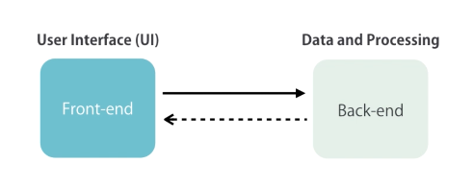
Perform CRUD operations

Slide 4
Perform CRUD operations
  Getting Data:
  http://jsonplaceholder.typicode.com/
  ng g c posts

Slide 5
Perform CRUD operations
  Getting Data:
  posts.component.ts: (add)
  constructor(http: HttpClient) {
  http.get('http://jsonplaceholder.typicode.com/posts')
  .subscribe(response => { this.posts = response;
  });
  }

Slide 6
Perform CRUD operations
  Getting Data:
  posts.component.html: (add)
  <ul class="list-group">
  <li *ngFor="let post of posts" class="list-group-item">
  {{ post.title }}
  </li>
  </ul>

Slide 7
Perform CRUD operations
  Greating Data:
  posts.component.html: (add)
  <input (keyup.enter)="createPost(title)" #title
  type="text" class="form-control">

Slide 8
Perform CRUD operations
  Greating Data:
  posts.component.ts: (add)
  createPost(input: HTMLInputElement) {
  let post = { title: input.value };
  input.value = '';
  this.http.post(this.url, JSON.stringify(post))
  .subscribe(response => {
  post['id'] = response.id;
  this.posts.splice(0, 0, post);
  // console.log(response);
  });
  }

Slide 9
Perform CRUD operations
  Updating Data:
  posts.component.html: (add)
  <button class="btn btn-default btn-sm"
  (click)="updatePost(post)">Update</button>
  posts.component.ts: (add)
  updatePost(post) {
  this.http.patch(this.url + '/' + post.id, JSON.stringify({ isRead: true }))
  .subscribe(response => {
  console.log(response);
  });
  }

Slide 10
Perform CRUD operations
  Deleting Data:
  posts.component.html: (add)
  <button class="btn btn-warning btn-sm"
  (click)="deletePost(post)">Delete</button>
  posts.component.ts: (add)
  deletePost(post) {
  this.http.delete(this.url + '/' + post.id)
  .subscribe(response => {
  let index = this.posts.indexOf(post);
  this.posts.splice(index, 1);
  });
  }

Slide 11
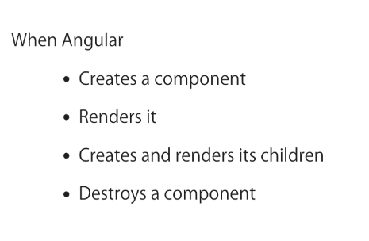
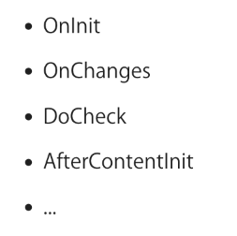
Perform CRUD operations
  Lifecycle Hooks:

Slide 12
Perform CRUD operations
  OnInit Interface:
  posts.component.ts:
  ngOnInit() {
  this.http.get(this.url)
  .subscribe(response => {
  this.posts = response;
  });
  }

Slide 13
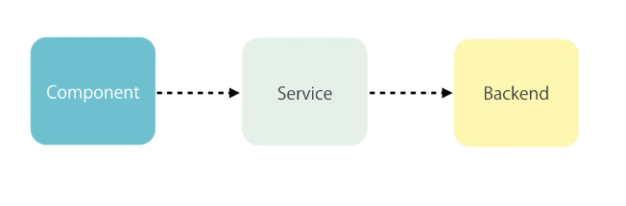
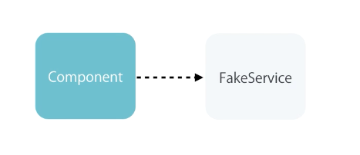
Reusable Data Service
  Separation of Concerns:

Slide 14
Reusable Data Service
  Extract a Service:
  ng g s post
  post.service.ts:
  getPosts()
  createPost(post)
  updatePost(post)
  deletePost(post)

Slide 15
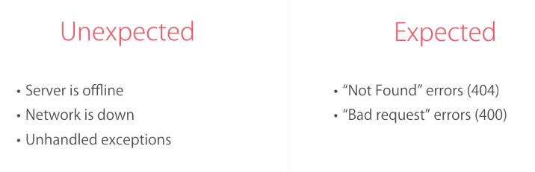
Handle Errors
  Handling Errors:

Slide 16
Handle Errors
  Handling Unexpected Errors:
  posts.component.ts:
  ngOnInit() {
  this.postService.getPosts()
  .subscribe(response => {
  this.posts = response;
  }, error => {
  alert('An unexpected error occurred.'); });
  }

Slide 17
Handle Errors
  Handling Expected Errors:
  posts.component.ts:
  deletePost(post) {
  (error: Response) => {
  if(error.status === 404) {
  alert('This post has already been deleted.');
  } else {
  alert('An unexpected error occurred.');
  console.log(error);
  }
  });
  }

Slide 18
Handle Errors
  Throw Application-specific Errors:
  post.service.ts:
  import { Observable } from 'rxjs';
  import 'rxjs/add/operator/catch’;
  deletePost(post) {
  return this.http.delete(this.url + '/' + post.id)
  .catch((error: Response) => {
  if(error.status === 404) {
  return Observable.throw(new NotFoundError());
  }
  return Observable.throw(new AppError(error));
  });
  }

Slide 19
Handle Errors
  Throw Application-specific Errors:
  app-error.ts:
  export class AppError {
  constructor(public originalError?: any) {}
  }
  not-found-error.ts:
  export class NotFoundError extends AppError {
  }
  posts.component.ts:
  deletePost(post) {
  if(error instanceof NotFoundError) {

Slide 20
Handle Errors
  Handling Bad Request Errors:
  post.service.ts:
  createPost(post) {
  return this.http.post(this.url, JSON.stringify(post)).catch((error: Response) => {
  if(error.status === 400) {
  return Observable.throw(new BadInput(error.json));
  }
  return Observable.throw(new AppError(error.json));
  });
  }

Slide 21
Handle Errors
  Handling Bad Request Errors:
  bad-input.ts:
  export class BadInput extends AppError {
  }
  posts.component.ts:
  createPost(input: HTMLInputElement) {
  (error: AppError) => {
  if(error instanceof BadInput) {

Slide 22
Handle Errors
  Global Error Handling:
  app-error-handler.ts:
  export class AppErrorHandler implements ErrorHandler {
  handleError(error) {
  alert('An unexpected error occurred.');
  console.log(error);
  }
  }

Slide 23
Handle Errors
  Global Error Handling:
  posts.component.ts: (update)
  ngOnInit() {
  createPost(input: HTMLInputElement) {
  updatePost(post) {
  deletePost(post) {

Slide 24
Handle Errors
  Extract a Reusable Error Handling Method:
  post.service.ts:
  private handleError(error: Response) {
  if(error.status === 400) {
  return Observable.throw(new BadInput(error.json));
  }
  if(error.status === 404) {
  return Observable.throw(new NotFoundError());
  }
  return Observable.throw(new AppError(error));
  }

Slide 25
Handle Errors
  Extract a Reusable Data Service:
  ng g s data
  data.service.ts:
  cut from post.service.ts
  post.service.ts:
  constructor(http: HttpClient) {
  super('http://jsonplaceholder.typicode.com/posts', http);
  }

Slide 26

Observables vs Promises

Slide 27
Summary

Slide 28
Assignment
  1. To render the Github Follower Page, use Boostrap Media Object. You can read about this component on Bootstrap website (getbootstrap.com) under Components.

Slide 29
Self Study
  Angular: Getting Started
  https://app.pluralsight.com/library/courses/angular-2-getting-started-update
  Angular HTTP Communication
  https://app.pluralsight.com/library/courses/angular-http-communication

